Slide 1
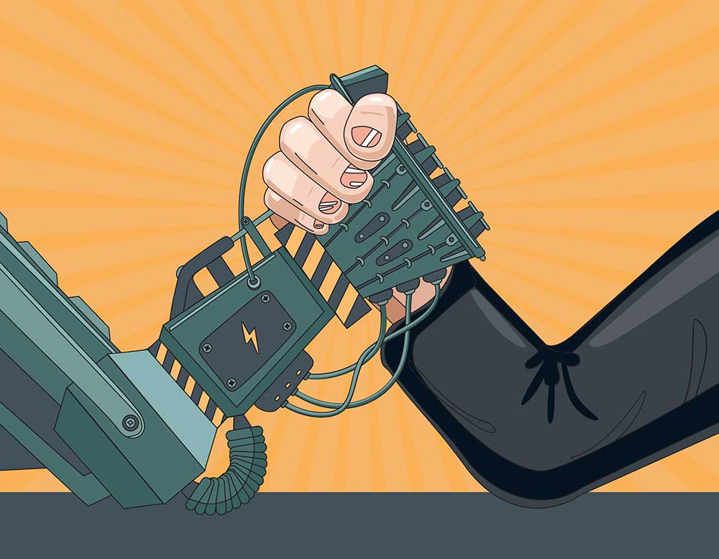
How Artificial Intelligence Affects Job Automation
By: Jason Van Wyck

Slide 2
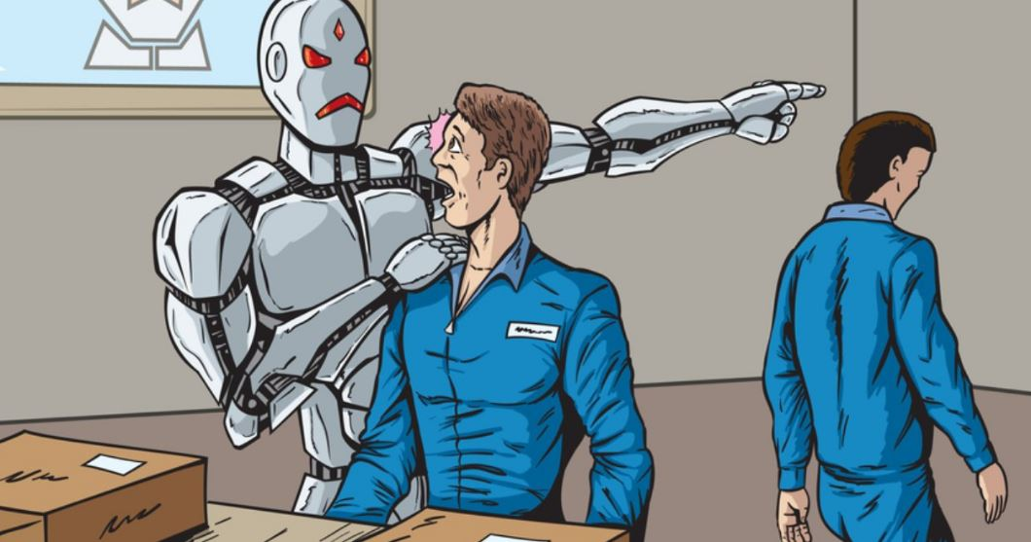
Key Issue
Problem: The labor force is at risk due to automation and the negative impact on jobs.
Hypothesis: Do higher paid jobs have less risk to automation than lower paid jobs?

Slide 3
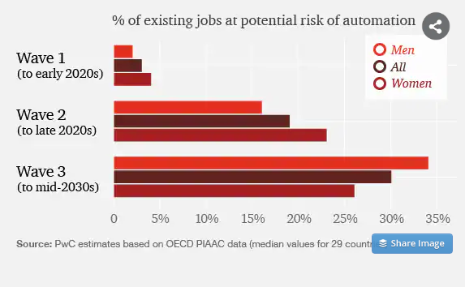
Key Issue Cont.
1st wave “Algorithmic” phase, women get affected the most as they are mostly in clerical and admin roles
2nd wave “Augmentation” phase, technology gets stronger and amplifies the 1st wave risk
3rd wave “Autonomy” phase, up to 30% jobs are likely to be automated. Men affected the most due to manual labor and increase in autonomous machines.
Notes:
https://www.cxcglobal.com/automation-impact-jobs

Slide 4
What does a higher or lower paying job constitute?
Jobs such as an Occupational Therapist or Physical Medicine and Rehabilitation Physicians are jobs with an average salary of over $86,280 and $206,500 that are higher paying that currently have a 0% chance of automation in the near future.
While other jobs such as cashiers, inspectors, and waiters which have lower paying salaries, all have a 90% chance of automation within the next 10 years and a 100% chance of automation within the next 25 years

Slide 5
Level of threat to a job
We usually think of low wages jobs as the immediate victim to automation.
MIT management explains threat to jobs are various and different categories of jobs and professions have different risk of having automation take over.
MIT gives the ex. A blue collar worker as an electrician has less risk to automation than a lawyer in the upcoming decades.
MIT explains that healthcare, education and trade jobs( electricians, plumbers, contractors etc.) are in the middle income bracket but have lower risk to automation than some white collar jobs. Such as lawyers, accountants, Finance professionals.
Trade jobs and healthcare have particular skills which require skilled hands on labor.
While some white collar jobs mentioned above can have AI programmed, trained and maintained to output more accurate information than humans can.
Notes:
https://www.cxcglobal.com/automation-impact-jobs

Slide 6
PWC research Predictions
Up to 30% of all jobs are expected to be be affected by automation by the year 2030.
30% of the jobs we reviewed are at risk for automation by 2030.
44% of workers are at risk of automation if they have lower levels of education.
Jobs for females are at high risk over the next few years. While men have the highest risk of automation for the future.
Notes:
https://www.cxcglobal.com/automation-impact-jobs

Slide 7
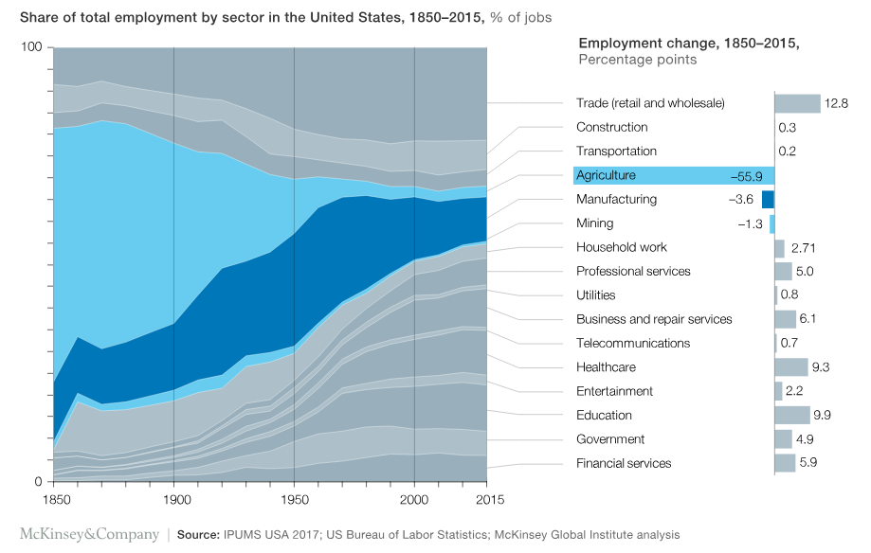
Employment change over history
Labor markets adjust to evolving technology and creates more jobs. Shown below is a shift of employment and sectors over history.
Notes:
https://www.cxcglobal.com/automation-impact-jobs

Slide 8
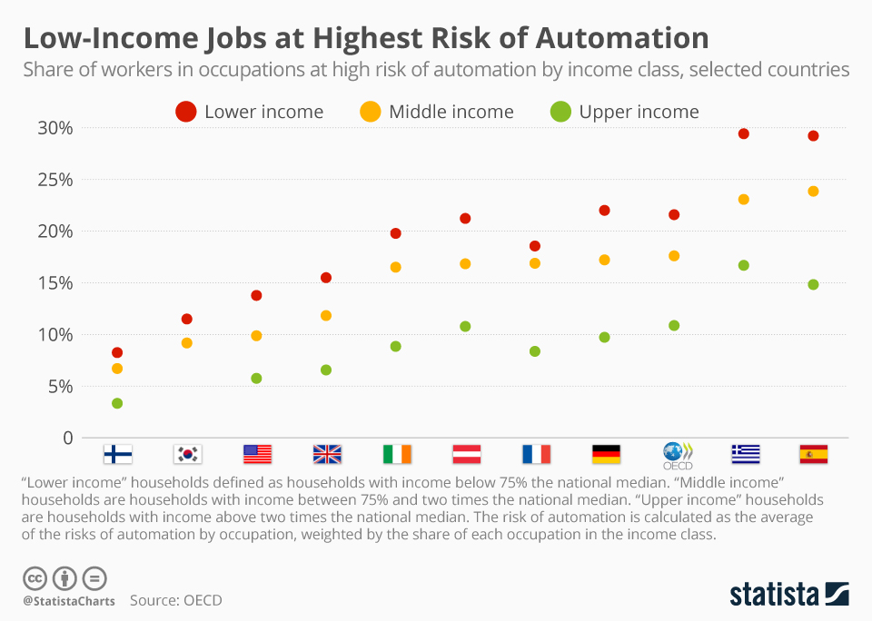
Low Income automation risk by Country
The chart shows how different countries will be affected by the mass risk of automation for low income jobs. The countries most affected by this include Greece and Spain which have job problems already. Countries such as Finland have a small risk margin for all 3 income classes primarily because of their health sector that has many jobs.
Notes:
• Chart: Low-Income Jobs at Highest Risk of Automation | Statista
Job automation risks vary widely across different regions within countries - OECD

Slide 9

Are there any high paying jobs at risk?
According to the data provided, they`re some jobs that are high paying but also have a high risk of automation by the year 2030. Some of these jobs include Equipment and Systems Inspectors, which make a median wage of $80,000 but have an automation rate of 90%. Another sector of the workforce that is high paying but also projected to be affected by job automation is Power plant Operators at 82%
Notes:
Top paying jobs with a high risk of automation by robots and AI (willrobotstakemyjob.com)

Slide 10
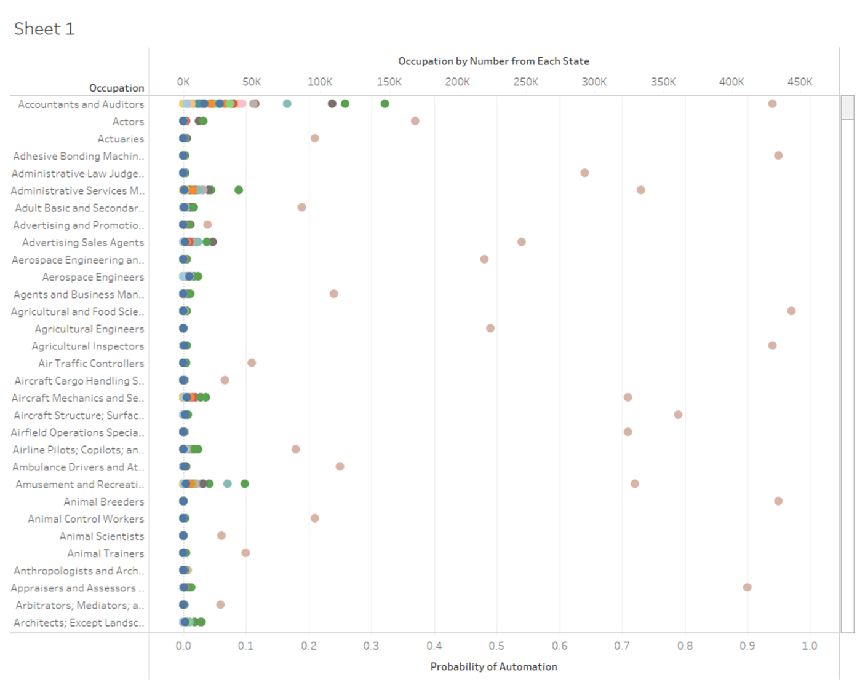
Jobs by state vs rate of automation
The chart shows different occupations with each dot representing a different state on each line. The further the dots move to the right, the higher the chances of automation are by the year 2030.
Notes:
https://www.kaggle.com/andrewmvd/occupation-salary-and-likelihood-of-automation

Slide 11
What can be done to stop job Automation?
One big way to attempt to prevent job automation is by investing into education.
Another way to slow down automation is to retrain in the private sector. The most successful training programs for companies have always been run by themselves, and many of these companies have begun to develop better and better programs for the workers.
Notes:
Job Automation and Unemployment. I often read articles or hear people… | by Garima Jajoo | Towards Data Science

Slide 12
What can be done to stop automation(Continued)
By having companies retrain their employees it allows them to take on different roles within a company instead of being limited to one part. Rather than firing and hiring people companies should utilize human capital and give them work that will intellectually stimulate them more.
Notes:
Job Automation and Unemployment. I often read articles or hear people… | by Garima Jajoo | Towards Data Science

Slide 13
Why Automation will one day take over
According to a report by McKinsey Global Institute nearly half of all jobs will be completely automated by 2055.
Productivity will grow globally by 0.8 to 1.4 annually with job automation
Removing humans eliminates errors and dips in production due to illness, fatigue, or other outside factors
Without human intervention, robots can be automated to work longer hours, for a more cost effect business strategy.
Notes:
New Study Predicts Nearly Half of All Work Will Be Automated (futurism.com)

Slide 14
Stopping automation in your life
Choose the right career path!
These jobs are expected to grow over the next 7 years
Data scientists and analysts
AI and machine learning specialists
Big data specialists
Digital marketing and strategy specialists
Process automation specialists
Business development professionals
Digital transformation specialists
Information security (IS) analysts
Software developers
Internet of Things (IoT) specialists
Why? AI must be programmed, trained and maintained
Notes:
https://www.datamation.com/artificial-intelligence/artificial-intelligence-and-automation/

Slide 15
Stopping automation in your life Cont.
These jobs are expected to decrease by 2025
Data entry clerks
Administrative and executive secretaries
Accounting, bookkeeping, and payroll clerks
Accountants and auditors
Assembly and factory workers
Business services and administration managers
Client information and customer service workers
General and operations managers
Mechanics and machinery repairs
Material-recording and stock-keeping clerks
Why? AI and various automation technologies take the primary role of these jobs.
Notes:
https://www.datamation.com/artificial-intelligence/artificial-intelligence-and-automation/

Slide 16
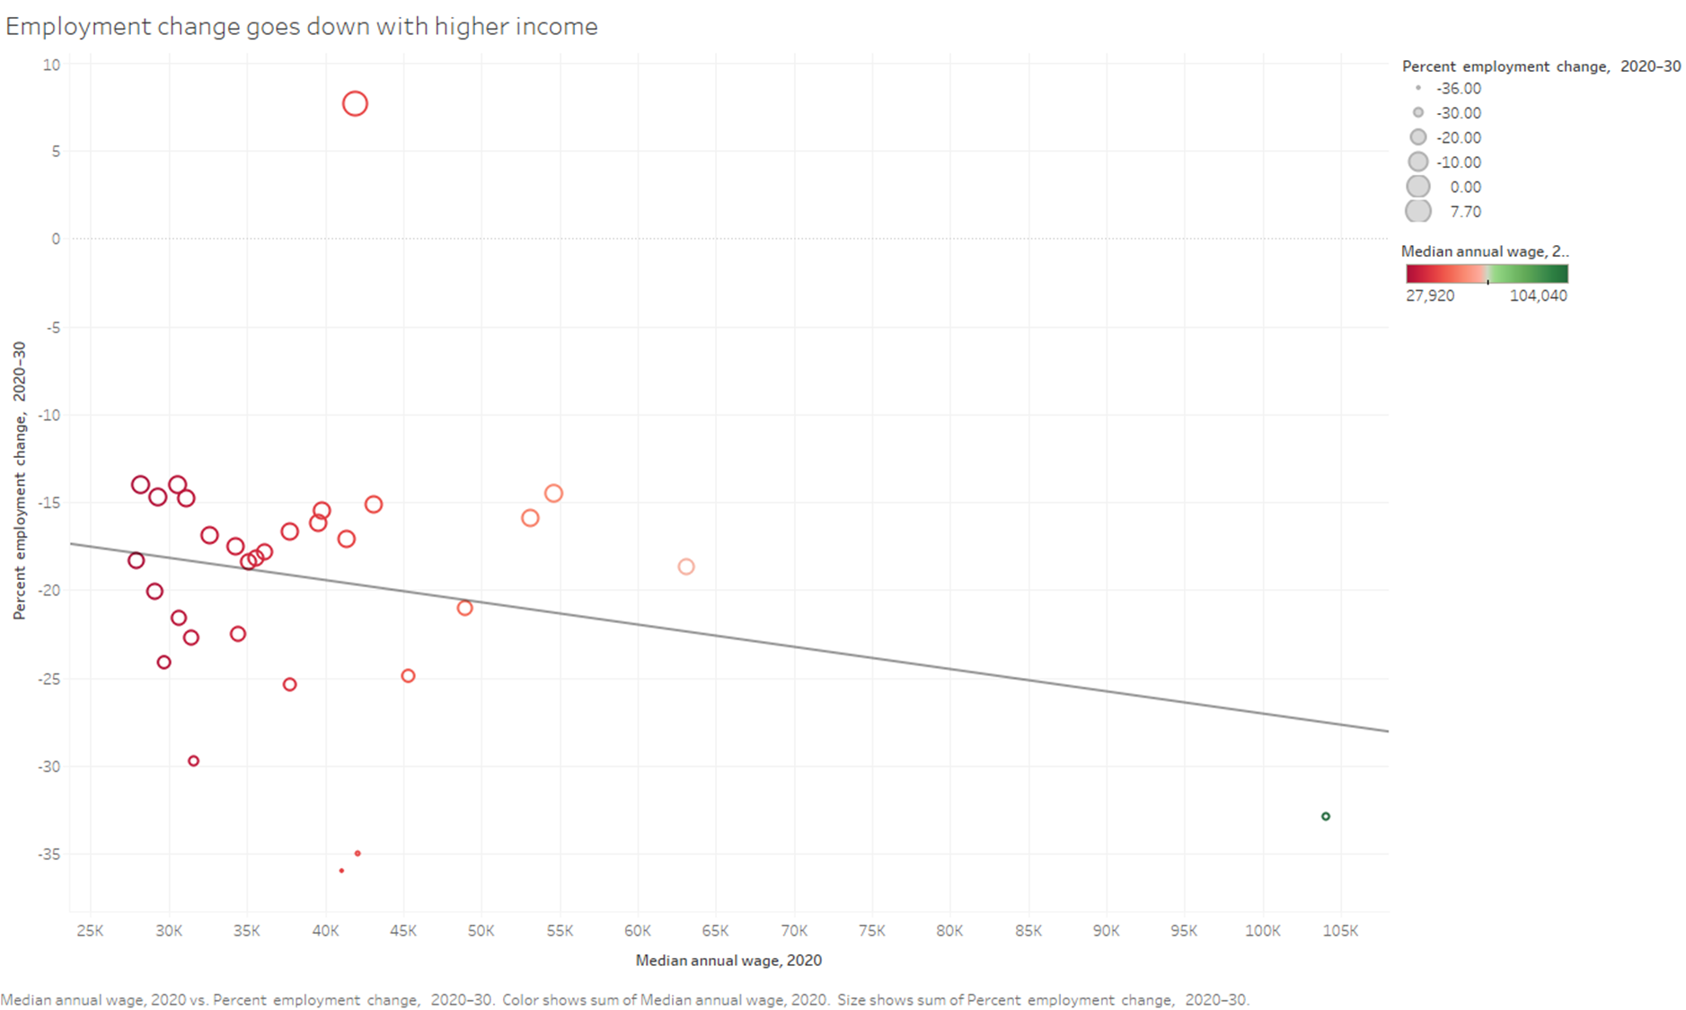
Linear Regression 1
Employment change goes down with higher income
R Squared = 0.0545631
P. Value = 0.20598
Notes:
https://www.kaggle.com/andrewmvd/occupation-salary-and-likelihood-of-automation

Slide 17
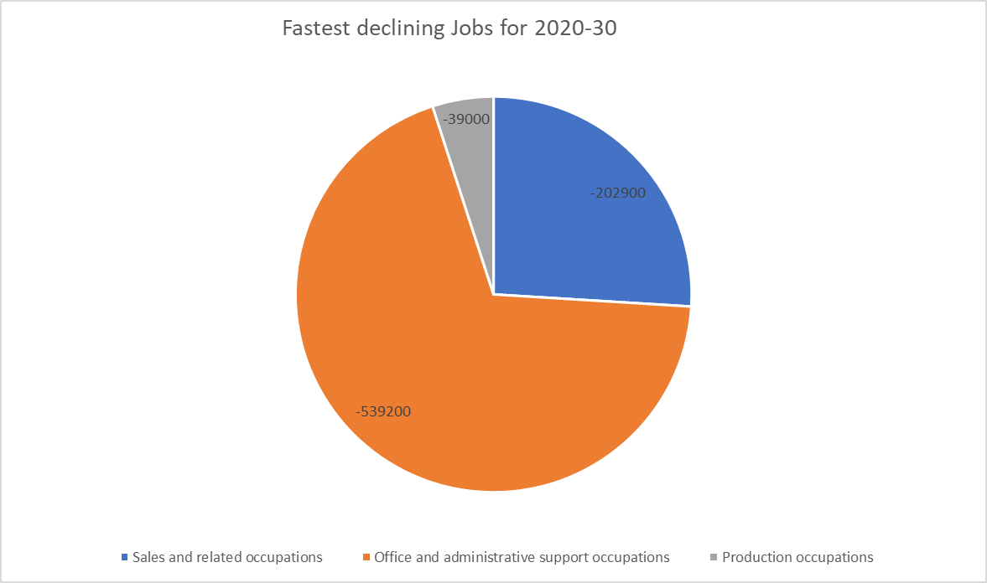
Stopping automation in your life Cont.
Notes:
https://www.fool.com/research/which-jobs-automated-10-years/

Slide 18
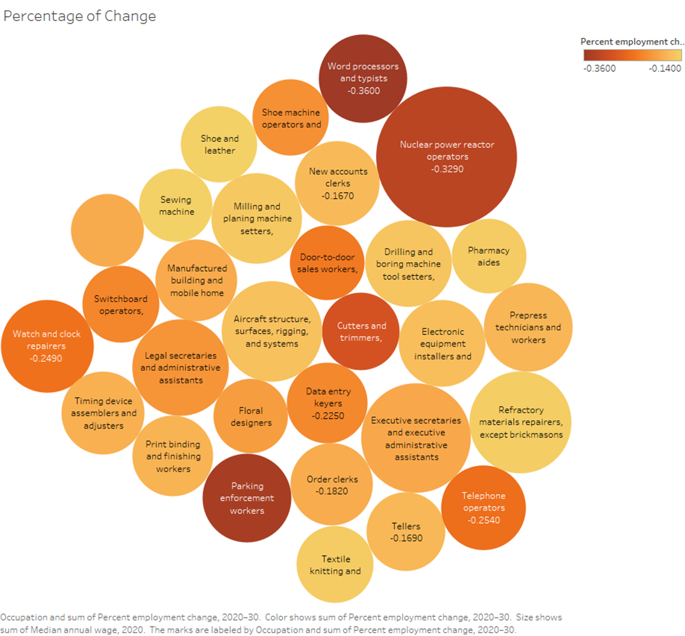
Percent Change in jobs
The bigger the circles means higher income
The darker the circles means more percentage of change
Notes:
https://www.fool.com/research/which-jobs-automated-10-years/

Slide 19
Recommendations
New Skills will be required for the AI world
AI will create new jobs but if the workforce doesn't evolve, then they run the high risk to being replaced by automation.
Employers should invest into education and new skill courses for their employees, such as data science, programming and other tech skills.
Employers should provide hands on training for developing and managing AI or data sets the organization uses.
Soft skill training, these are skills that are very difficult for AI to mimic.
Soft skills such as leadership, conflict resolution, entrepreneurship, creative thinking etc.
Employers should offer continuous conferences and seminars to develop employees for the future.
Notes:
https://www.datamation.com/artificial-intelligence/artificial-intelligence-and-automation/

Slide 20
Conclusion
AI Automation will very likely replace or transform many of the jobs we see in the labor market.
Many lower paying jobs such as cashiers,waiters, and inspectors are at very high risk to lose their jobs in the near future, some high paying jobs are at risk also.
According to the statistics, this epidemic of job automation will affect most countries in the world heavily, while some countries such as Finland and South Korea won`t be as affected as much.

Slide 21
Data Sets
Data prep
Cleansing data, deleting null values, deleting duplicates, deleting specific organization coding that means nothing to the average user.
Having to manually type up data sets from websites into excel.
https://www.kaggle.com/andrewmvd/occupation-salary-and-likelihood-of-automation
https://www.cxcglobal.com/automation-impact-jobs
https://www.fool.com/research/which-jobs-automated-10-years/
https://www.datamation.com/artificial-intelligence/artificial-intelligence-and-automation/
https://www.bls.gov/emp/tables/fastest-declining-occupations.htm

Slide 22

Questions?

